Slide 1

FINAL PROJECT
ELECTRICAL SERVICES DESIGN LABORATORY
Course No: EEE 414
ELECTRICAL SERVICES DESIGN PROJECT
Group: 05
Presented By
1806071 - Promit Biswas
1806084 - KM Zulfikkar Sadik
1806085 - Rudra Roy
1806094 - Yeasmin Jahan Rima
1806074 - Promit Ghosh
1806083 - Emaz Elmi

Slide 2

Introduction
We were instructed to model a three storied building having 2 units. Also, an instruction was to implement a parking & a basement having enough space. An elevator is also installed to ensure the ease of going any apartment without any time delay. Necessary safety managements have also been taken to ensure public safety

Slide 3
Objectives
1. To get introduced to the floor-planning process of a typical multi-storied residential building.
2. To be familiarized with various fittings and fixtures utilized in each compartment of the building.
3. To get guidance on systematically drawing conduit layouts for the building.
4. To understand switchboard connections, including emergency setups.

Slide 4
Design Steps
Ground floor and typical floor plan of a 3-storeyed building
Fittings and fixtures for each floor
Conduit layout planning for each floor
Switchboard and distribution board diagram

Slide 5
Main Floor Plan

Slide 6
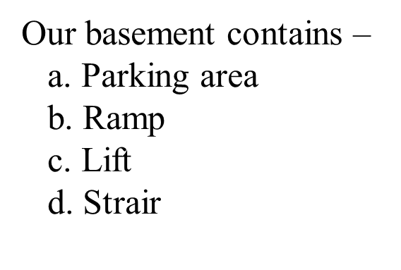
Basement

Slide 7



Slide 8
Ground Floor
Our ground floor contains –
a. 1 Guard Room
b. Stair
c. 1 Toilet
d. Generator Room
e. MDB room
f. Transformer Room
g. Exit
Also, a lift is installed in Ground floor.

Slide 10
First Floor
We have 2 units i.e. 2 apartments in each floor.
Every apartment consists of –
a. 1 Master Bedrooms
b. 2 Bedroom
c. 1 Living Room
d. 1 Dinning Space
e. 1 Kitchen
f. 3 Toilets
g. Free space as in Veranda
Also, a lift is installed in every floor

Slide 12
Floor Plan with Electrical Fittings

Slide 13
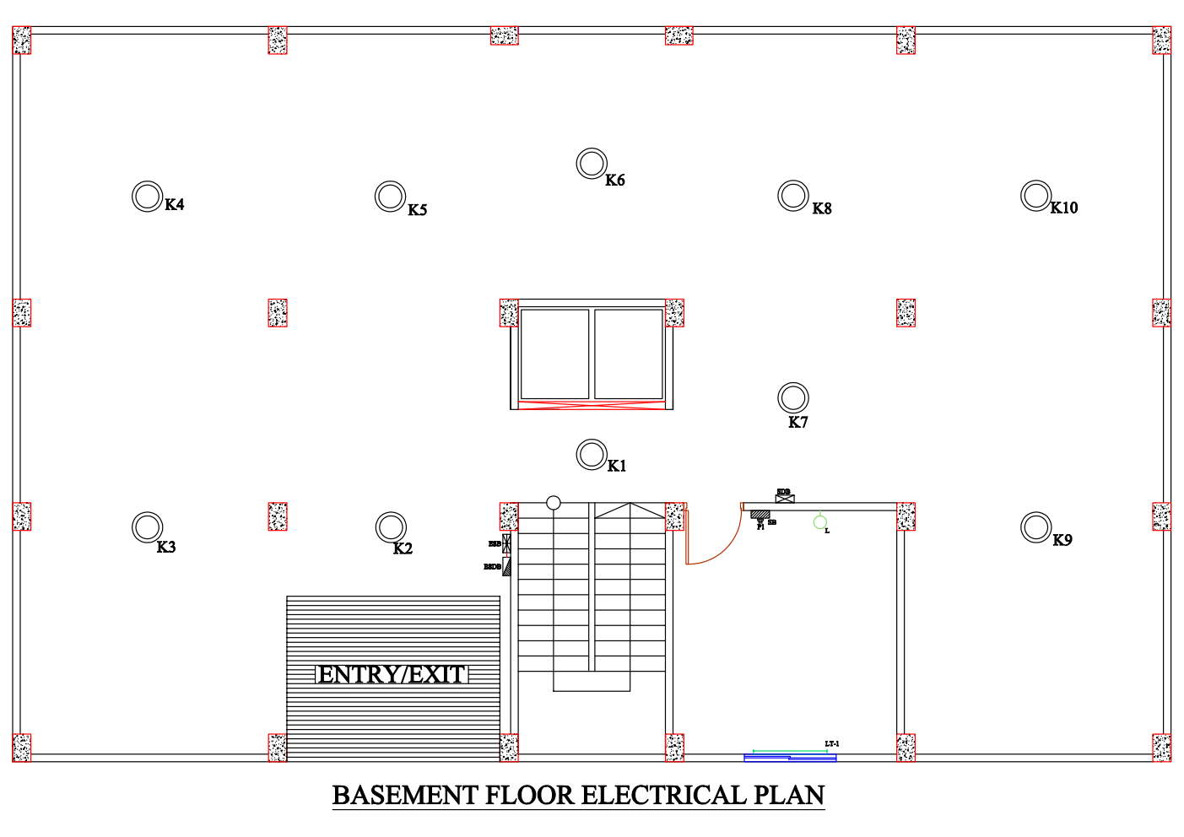

Slide 14
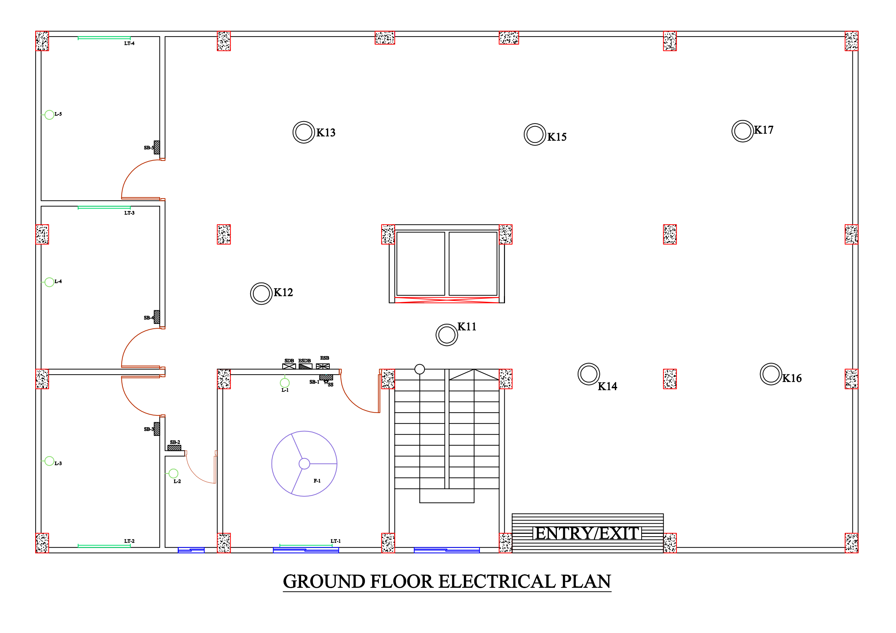

Slide 16
Floor Plan with Conduit

Slide 20
Roof Layout

Slide 22
Distribution Board Circuit Diagram

Slide 23
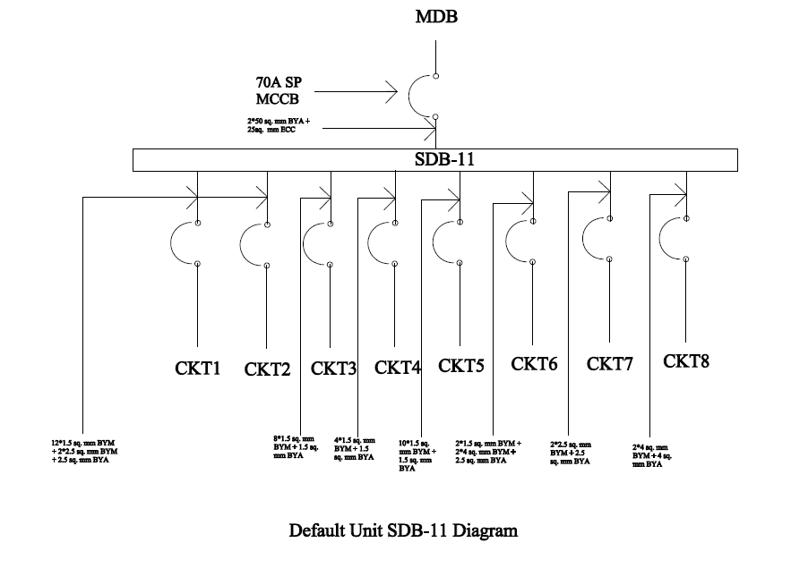

Slide 24
Sub Distribution Board

Slide 25
Emergency Sub Distribution Board

Slide 26
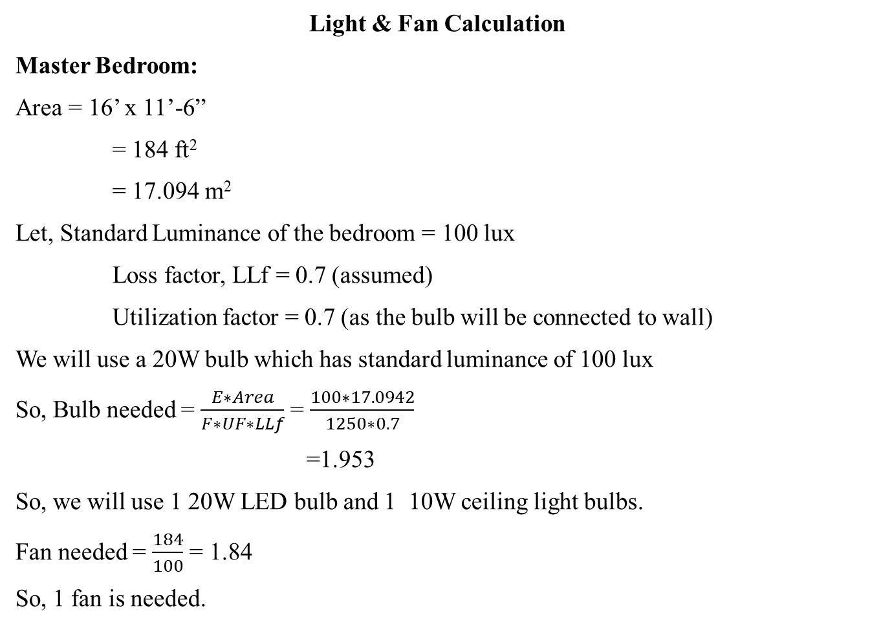
Sample Calculations
Light & Fan Calculation
Master Bedroom:
Area = 16’ x 11’-6”
= 184 ft²
= 17.094 m²
Let, Standard Luminance of the bedroom = 100 lux
Loss factor, LLf = 0.7 (assumed)
Utilization factor = 0.7 (as the bulb will be connected to wall)
We will use a 20W bulb which has standard luminance of 100 lux
So, Bulb needed = $\frac{E∗Area}{F∗UF∗LLf}$ = $\frac{100∗17.0942}{1250∗0.7}$
=1.953
So, we will use 1 20W LED bulb and 1 10W ceiling light bulbs.
Fan needed = $\frac{184}{100}$ = 1.84
So, 1 fan is needed.

Slide 27
Power Calculation
Basement
For SB
Total load = 40 × 0.7 + 3000 × 0.2 = 628 Watt I=628/(220×0.7)=4.0779 A
∴2 × 1.5 rm BYM + 1.5 rm BYA ECC are used.
For SDB
Total load = 628 Watt
I=628/(220×0.7)=4.0779 A
∴2 × 1.5 rm BYM + 1.5 rm BYA ECC are used.
For ESB
Total load = 200 Watt
I=200/(220×0.7)=1.298 A
∴2 × 1.5 rm BYM + 1.5 rm BYA ECC are used.
For ESDB
Total load = 200 Watt
I=200/(220×0.7)=1.298 A
∴2 × 1.5 rm BYM + 1.5 rm BYA ECC are used.

Slide 28

THANK YOU

